Slide 1
Advanced Modeling for Distribution Planning Workshop with OpenDSS
Instructors
Roger C. Dugan Matt Rylander
Sponsored by CenterPoint Energy At Texas A&M University April 19, 20, 21

Slide 2
Running from MATLAB

Slide 3
Running OpenDSS From Matlab
Starting the DSS
%Start up the DSS
[DSSStartOK, DSSObj, DSSText] = DSSStartup(cd);
function [DSSStart,DSSobj,DSSText] = DSSStartup(mydir)
% Function for starting up the DSS
% make sure we are in the proper directory
cd(mydir);
%instantiate the DSS Object
DSSobj = actxserver('OpenDSSEngine.DSS');
%Start the DSS. Only needs to be executed the first time w/in a Matlab session
DSSStart = DSSobj.Start(0);
% Define the text interface
DSSText = DSSobj.Text;

Slide 4
Using the COM to Script Multiple Scenarios
DSSText.command = 'compile master.dss';
DSSText.command = 'New PVsystem.PV_1 phases=3 conn=delta bus1=LoadBus kV=12.47 kVA=1 Pmpp=1 pf=1';
DSSText.command = 'calcv';
DSSText.command = 'solve';
PVsize = 100:100:20001;
for ii=1:length(PVsize)
DSSText.command = ['edit PVsystem.PV_1 kVA=',num2str(PVsize(ii)*1.2),' pmpp=',num2str(PVsize(ii))];
DSSText.command = 'solve';
DSSObj.ActiveCircuit.Buses('LoadBus');
puvoltages = DSSObj.ActiveCircuit.ActiveBus.puVoltages;
puvoltage(ii) = sqrt(puvoltages(1)^2+puvoltages(2)^2);
end
Compile simple circuit
Add PV system
Modify the a PV size
Observe the feeder voltage

Slide 5
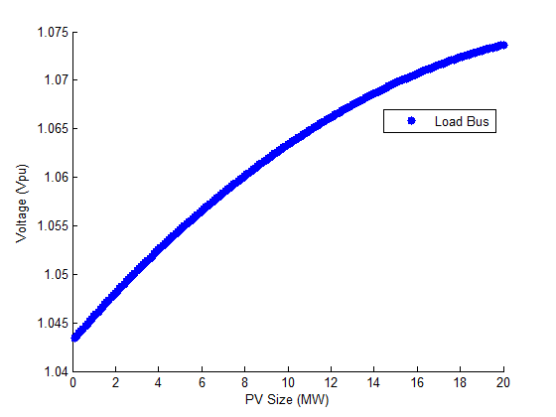
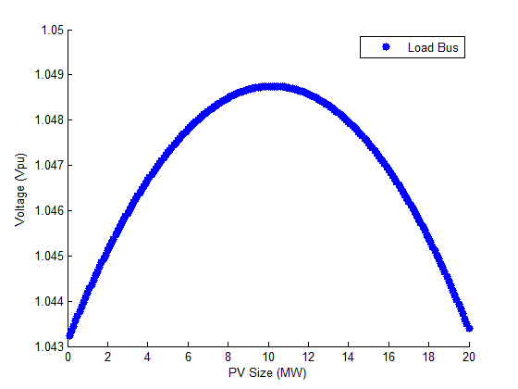
Load Bus Voltage for Multiple Scenarios
PV @ Unity Power Factor
PV @ -0.99 Power Factor

Slide 6
COM Server and Matlab Examples
Using Matlab

Slide 7
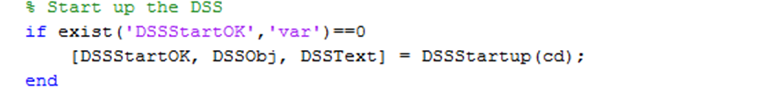
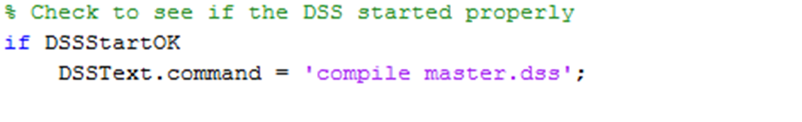
Create a New Matlab .m file
DSSStartup.m must be in the same directory
First statement in the new file must activate OpenDSS COM object
The next statement checks if DSS loaded correctly and then compiles the simple feeder

Slide 8
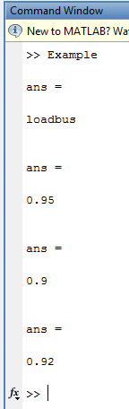
Communicate with the DSS Model
Select and examine an elements properties
Modify the load power factor explicitly
Modify the load power factor generically

Slide 9
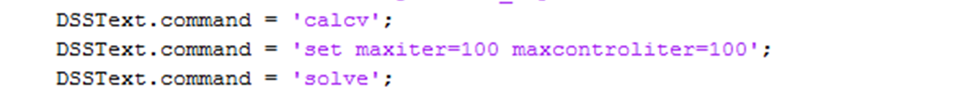
Add an Element to the Model
Text based command
Add PV system
Calc V to refresh voltage bases
Modify settings
Solve

Slide 10
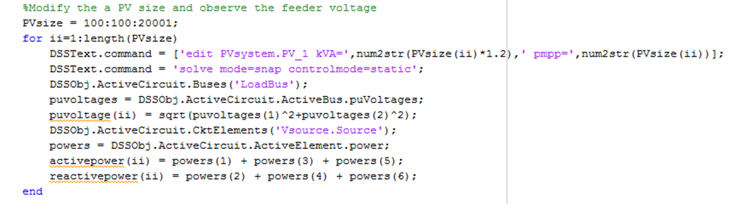
Scripting for Automated Analysis
Analyze different size PV systems to determine when ANSI voltage limits are violated
Record voltages
Record power flow

Slide 11
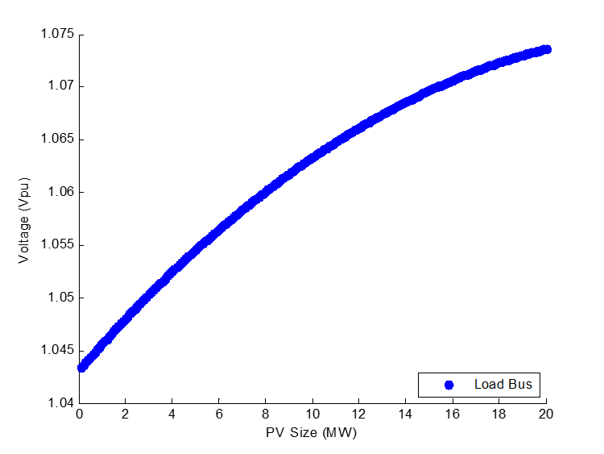
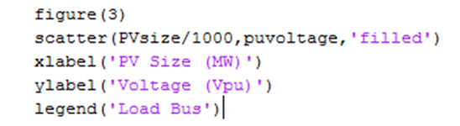
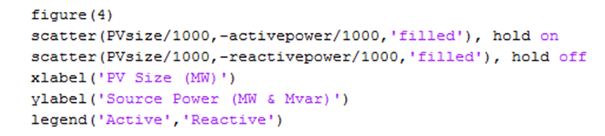
Observe Results Plotted in Matlab
Voltage at PV Terminal
Power from Source

Slide 12
Repeat with Off-nominal PV Power Factor
Voltage violation avoided by absorbing vars @ -0.99 pf
Voltage at PV Terminal
Power from Source

Slide 13
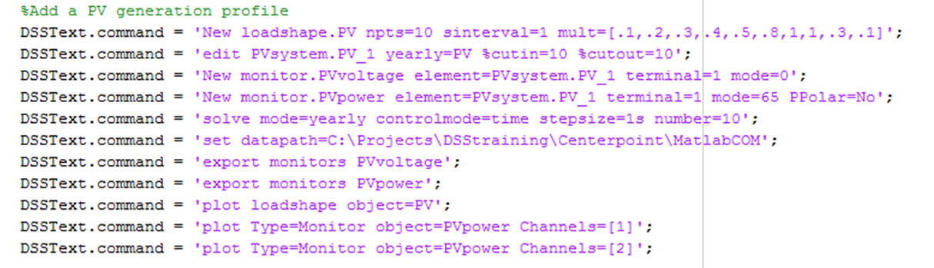
Time Series with Variable Resource
Create a simple loadshape to simulate PV variability
%cutin and %cutout impact when the PV will be online
Setup monitors to record results
Solve
Observe results

Slide 14
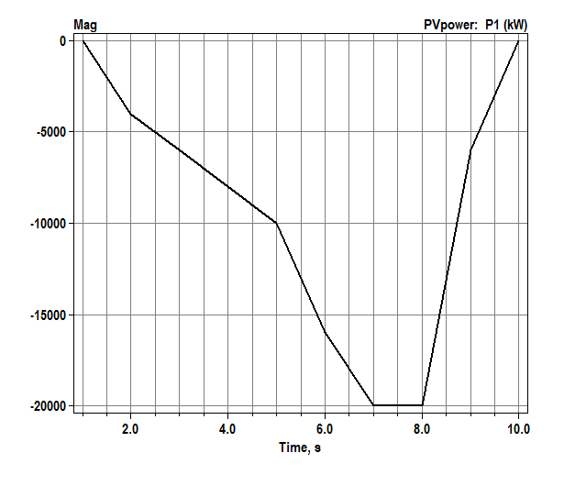
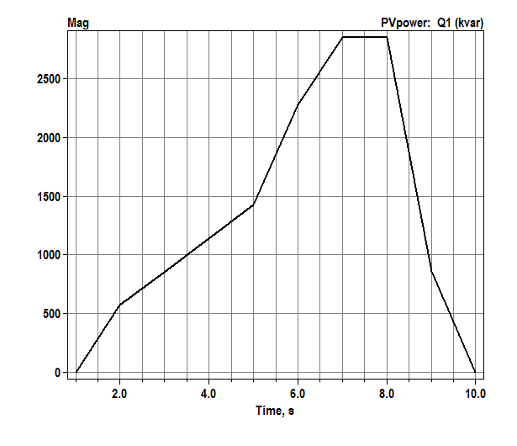
Time Series Results Plotted by DSS
Real power multiplication factors
mult=[.1,.2,.3,.4,.5,.8,1,1,.3,.1]
Offline in first and last interval due to cutin/cutout

Slide 15
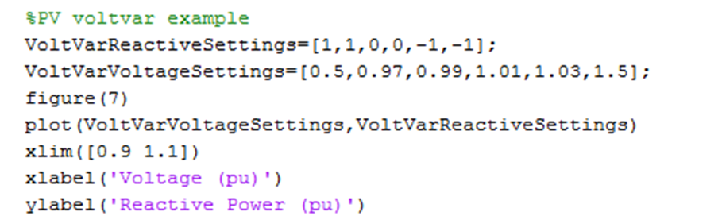
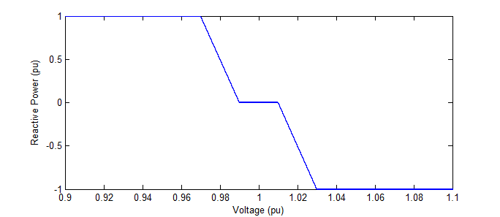
Adding Voltvar to the Mix
Create voltvar settings
Apply to the PV system inverter

Slide 16
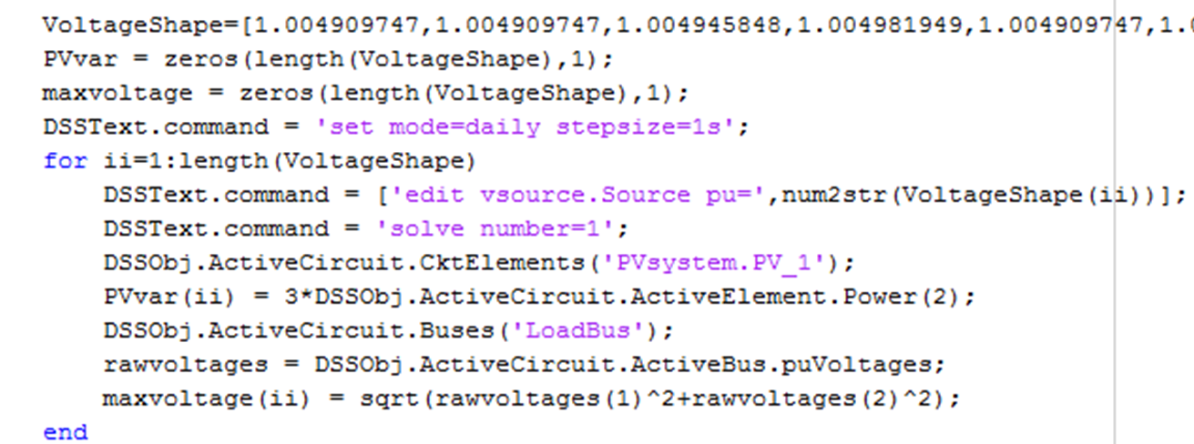
Observe Inverter Voltvar Response
Vary the system voltage
Record the inverter reactive response

Slide 17
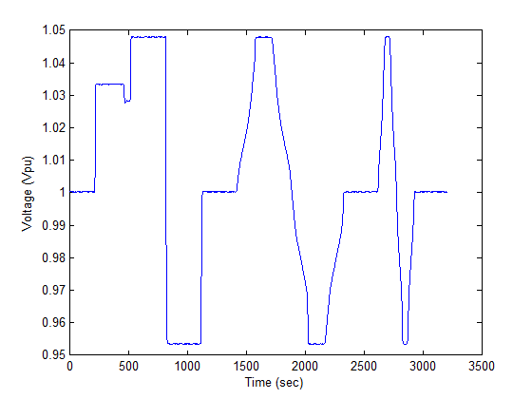
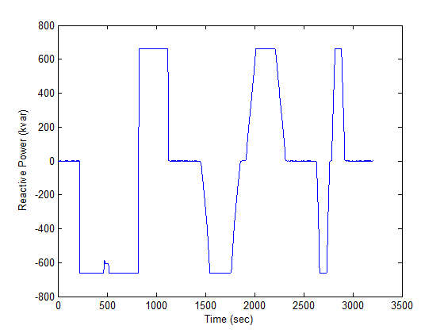
Observe Voltvar Response
Full reactive output above 1.03 Vpu
No reactive output from 0.99-1.01 Vpu

Slide 18
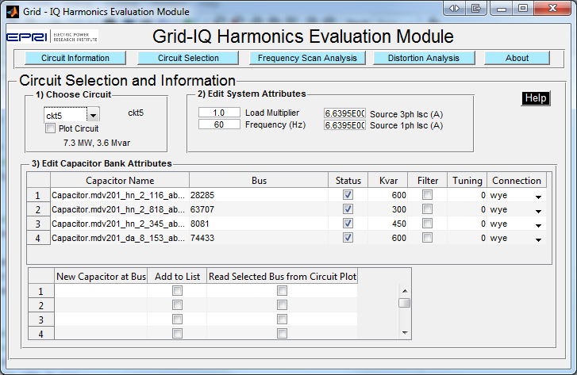
Graphical User Interface in Matlab

